Slide 1
Gowanus Neighborhood Rezoning Seminar Series
September 9, 2021

Slide 2
Background

Slide 3
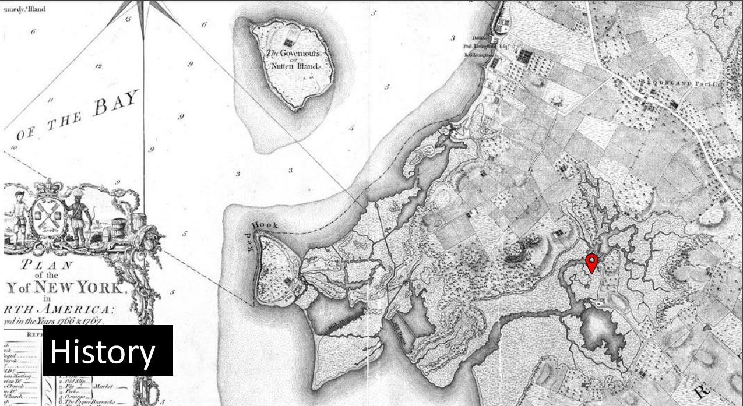
History of Development
Pre-colonial Times: The Gowanus Creek
Canarsee Indians
Oysters and fishing
Significant marshland adjoining the creek
Dutch and English Settlements: 17th and 18th Century
Purchased from indigenous people by Dutch West India Company
Land distributed in large parcels to “Patroons.”
English continued agricultural uses throughout 17th and 18th centuries, with lands divided into smaller farms, with several mills established in late 18th
Much of area was marsh and inundated by waters

Slide 4
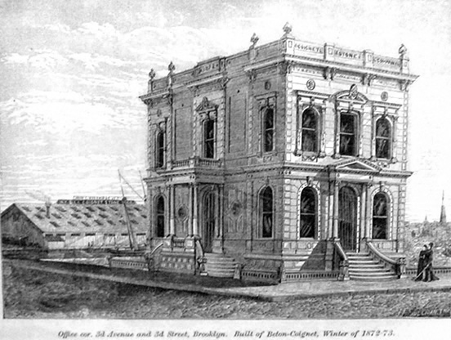
History of Development
19th Century Residential Development
Residential development occurred at or around the time of the incorporation of the City of Brooklyn in 1834
Lands divided into smaller parcels
Marsh was filled to create developable parcels
Canal created from 1840s to 1870 by filling wetlands and installing bulkheads

Slide 5
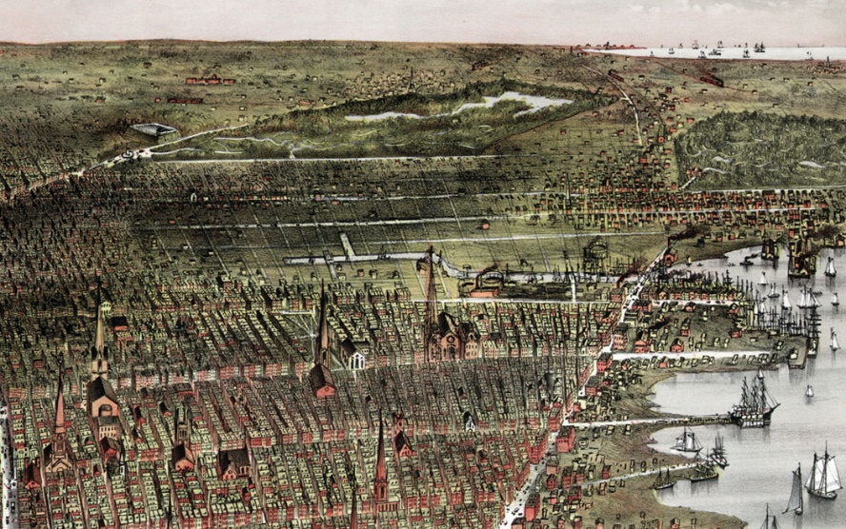
History of Development
Industrial Development in Late 19th Century
Spurred by creation of the current 1-mile canal with turnarounds
All of the wetlands were filled
Oystering and farming replaced by MGPs and other industrial uses.
Paint and Inking plants
Coal and Oil
Foundries
Electroplating

Slide 6
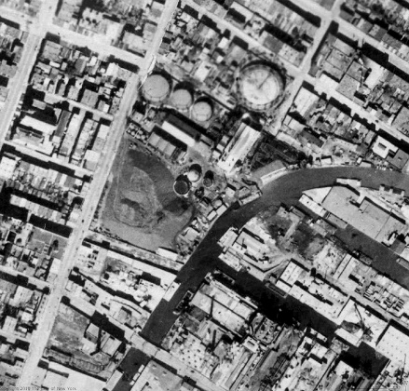
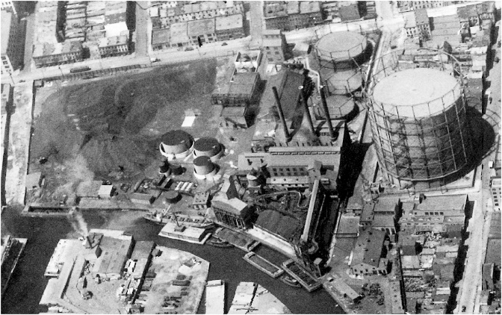
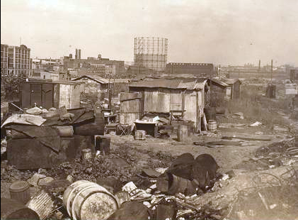
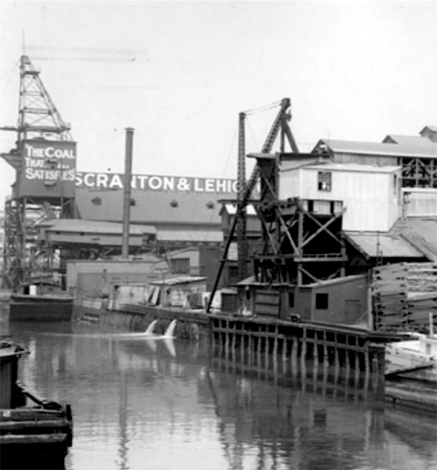
History of Development
Industrial Development in Late 19th Century (continued)
Significant dumping and leaching of contaminants into soils and the canal
Removal of wetlands eliminated filtering
20th Century
Significant industrial uses continued
Flushing Tunnel Created to allow for flushing of contaminants (1911)
Failed uses in surrounding area changed as Brooklyn changed

Slide 7
Contamination
Contaminants in Canal sediments include VOCs, PAHs, and Metals
Sewage from CSO outfalls trapped in water and sediments
Contaminants in soils and groundwater in neighborhood persist, particularly at MGP sites

Slide 8
Brownfield Opportunities Area Created in 2014
Allows for enhanced BPC tax credits

Slide 9
Superfund Designation and Remediation
US EPA places Gowanus on the National Priorities List -2009
Site designated as a Superfund Site in 2010
2013- Remedy Selected
Dredging of sediments in canal and multi-layer “cap”
Estimated Cost is $1 billion
EPA expects commencement in late 2022
Two CSO facilities- underwater tunnels to capture outfall in overflow situations
Upland remediation of MGPs – National Grid is the PRP, along with NYC

Slide 10
Gowanus Neighborhood Plan

Slide 11
Neighborhood Plan – Community Outreach

Slide 12
Neighborhood Plan Goals
Gowanus: A Framework for a Sustainable, Inclusive, Mixed-Use Neighborhood Structured around community priorities and organized by goals and strategies
Sustainability and Resiliency
Make Gowanus a model green neighborhood, and encourage flood-resilient buildings and community preparedness
Environmental Remediation
Support continuing clean-up of the Gowanus Canal and properties across the neighborhood
Community and Cultural Resources
Connect parks and public areas through an open space green network
Expand space opportunities for art and cultural uses and leverage new publicly accessible open space along the waterfront for programming

Slide 13
Neighborhood Plan Goals
Gowanus: A Framework for a Sustainable, Inclusive, Mixed-Use Neighborhood Structured around community priorities and organized by goals and strategies
Housing
Support individuals and families to achieve economic stability, live in safe and healthy homes, and enjoy a sense of community that allows people of all different backgrounds to call Gowanus home
Economic and Job Development
Promote economic development, increase access to jobs and workforce development opportunities, align land use strategies with a vision that balances a mix of uses and remove barriers in zoning that limit the growth of businesses
Transportation
Support addressing transportation issues and opportunities that can enhance safety, mobility, circulation and safety for pedestrians, cyclists and motorists

Slide 14
Neighborhood Plan Goals
Land Use and Urban Form
Waterfront Access
Shape a unique, resilient waterfront open space
A True Mix of Uses
Incentivize non-residential uses
Create and enhance key corridors and nodes
Activate the canal
Built Form
Relate to neighborhood context
Allow for an architectural variety along the canal
Maintain light and air to the future waterfront
Promote resiliency and sustainability

Slide 15
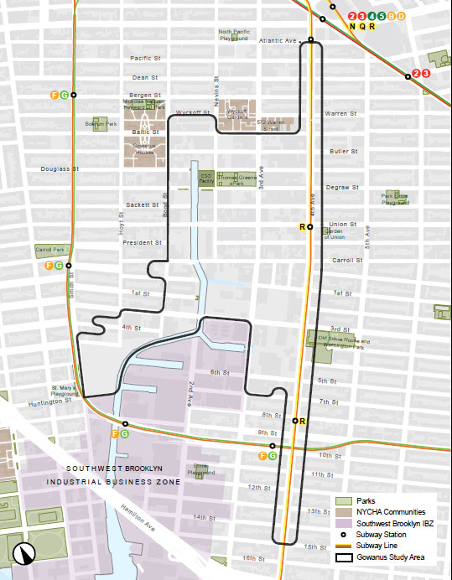
Gowanus Neighborhood Plan Rezoning
Geographic Area Covered by Rezoning

Slide 16
Gowanus Rezoning – Land Use Actions
Zoning Map Amendments
The Land Use Actions would replace all or portions of existing R6, R6B, R8A, R8A/C2-4, C8-2, M1-1, M1-2, M2-1, and M3-1 zoning districts with R6A, R6B, M1-4/R6A, M1-4/R6B, M1-4/R7-2, M1-4/R7A, M1-4/R7X, C4-4D, and M1-4 zoning districts
Zoning Text Amendments
Creation of the Special Gowanus Mixed Use District
Mapping of an MIH area
City Map Amendments
Mapping of new streets and parkland, elimination of certain streets
Urban Development Action Area Project and Disposition of City Owned Property
Designation of portion of Block 471 as a UDAAP to facilitate the development of the Gowanus Green project
Disposition of City-Owned Property
To facilitate the transfer of development rights from City-owned property

Slide 17
Gowanus Rezoning Framework
Special Gowanus Mixed Use District
Five Subdistricts
Subdistrict A – Fourth Avenue Subdistrict
Subdistrict B – Upland Blocks Subdistrict
Subareas B1 and B2
Subdistrict C – North Canal Corridor Subdistrict
Subdistrict D – South Canal Corridor Subdistrict
Subareas D1 through D6
Subdistrict E – First Street Subdistrict
Gowanus Canal Waterfront Access Plan

Slide 18
Special Gowanus Mixed Use District
Special Use Regulations
Gowanus Mix Uses (ZR Sec. 139-12)
Uses include light industrial, arts-related, cultural, civic and repair type uses
Floor area ratio bonus available when such uses are incorporated into buildings located within M1 Districts paired with R7-2 and R7X Districts
Gowanus Retail and Entertainment Uses (ZR Sec. 139-13)
Wide range of retail and entertainment-related uses including restaurants, retail stores, art galleries, etc.
Ground floors on primary street frontages are limited to Gowanus Retail and Entertainment Uses
Physical Culture or Health Establishment Uses Permitted As-of-Right
Transient Hotels require CPC Special Permit

Slide 19
Special Gowanus Mixed Use District
Zoning Districts – Permitted FAR

Slide 20
Special Gowanus Mixed Use District
Bulk Regulations – Floor Area Regulations
Increase with Non-Residential and Gowanus Mix Uses (ZR Sec. 139-212)
Up to 0.2 FAR bonus for including non-residential uses and up to 0.4 FAR bonus available for including Gowanus Mix Uses in M1 Districts paired with R7-2 and R7X districts
Certification for Transit Improvements
20% FAR increase available for transit improvements in Commercial Districts
Schools
Schools built for NYC Dept. of Ed. can be exempted from floor area
Comfort Stations
For buildings fronting on WPAAs, floor area exemption available for construction of comfortable stations

Slide 21
Special Gowanus Mixed Use District
Bulk Regulations – Height
Height and setback regulations vary by subdistricts and subareas
Increased heights contemplated along Third and Fourth Avenue corridors as well as large sites front Gowanus Canal
Tower regulations permitted for Subdistricts C and D
Specific rules vary by subdistrict/ subarea to specifically guide development and ensure access to light, air and views of Canal

Slide 22
Special Gowanus Mixed Use District
Waterfront Access Plan
All blocks/zoning lot adjoining Gowanus Canal are waterfront blocks/zoning lots
Waterfront Access Plan tailors waterfront public access to unique built environment and features of the Canal
WAP dictates the public amenities (visual corridors, waterfront public access, supplemental public access)
Zoning lots with 5.0 FAR must provide 20% of lot area as WPAA, zoning lots with 3.0 FAR must provide 20% WPAA

Slide 23
Gowanus Green Development
Approx. 950 of affordable housing in six buildings to be developed on City-owned property by a joint venture of Fifth Avenue Committee, Bluestone Organization, the Hudson Companies and Jonathan Rose Companies with space reserved for a new school to accommodate population growth in the area.

Slide 24
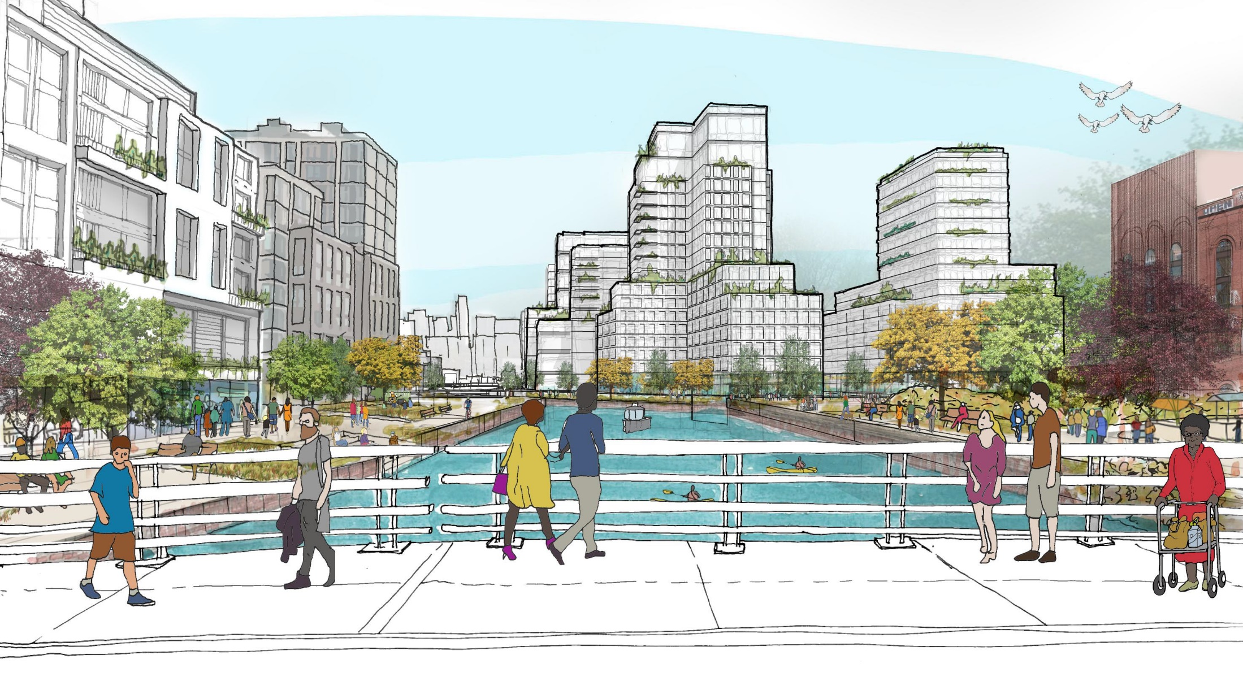
Future Vision for Gowanus
Illustrative drawing prepared by NYC Department of City Planning

Slide 25
Status of Public Review

Slide 26
Status of Public Review
Certified on April 19, 2021
Brooklyn Community Boards 2 and 6
CB 2 – unfavorable recommendation issued June 21, 2021
Cited need for canal clean up before any residential development permitted
CB 6 – approved with conditions on June 23, 2021
Main concern was fully funding the capital needs of local public housing
Other conditions include City funding of Gowanus Zoning Commitment Task Force, CSO oversight, EPA review of Public Place and individual Brownfield applications, making the "Gowanus Mix" program mandatory, mandating MIH Option 3 (or 1 and 3), Gowanus IBZ vision plan, provision of municipal services, open space investments and a Parks Improvement District, climate and flood resiliency, transit investments, additional Waterfront Access Plan requirements such as programming, and zoning modifications including a height cap

Slide 27
Status of Public Review
Certified on April 19, 2021
Brooklyn Borough President - Approved with conditions on August 24, 2021
Conditions included that City dedicate 5-year capital funding for NYCHA physical needs, HPD requirements for LDA with Hudson Inc., less height for Parcel D4, pedestrian bridge to the Salt Lot, Hoyt Street extension be constructed as a shared street, considerations for NYCHA if not fully funded, allow mapping of Option 3 without Option 1, adequate public school seats, maximize Gowanus Mix creation and retention, advancing stormwater management, promoting transit access and transit modes, appropriate bulk, WAP modifications, and planning and policy items beyond what's currently proposed in the Gowanus Plan
City Planning Commission - Public hearing held July 28, 2021
Issues raised included CSOs, NYCHA, environmental/remediation, zoning issues including heights/shadows around Thomas Greene Playground, local retail, open space, displacement concerns
Vote will be 9/20 or 9/22, review period ends on 9/24
City Council
50 day review period (tentatively ending by 11/10)
Potential CPC review of proposed modifications (scope determination)

Slide 28
Upcoming Gowanus Series Events
Production of Affordable Housing – Thursday, October 7, 2021 @ 1:00 PM
Updates on public review, overview of residential components of rezoning, Mandatory Inclusionary Housing and Process, and Affordable New York Program (421-a(16)) vesting
Preserving the Gowanus Mix – Thursday, November 4, 2021 @ 1:00 PM
Updates on public review, overview of non-residential components of rezoning, economic incentives for non-residential development projects
The Future of Gowanus – Thursday, December 16, 2021 @ 1:00 PM
Overview of completed public review process, highlights of any amendments to land use actions, insights on the future of Gowanus

Slide 29
Q + A

Slide 30
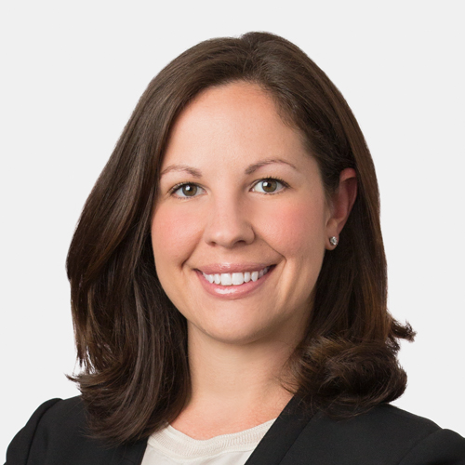
Contact Us
Joshua J. Rinesmith
Eleanore C. Martins
Richard G. Leland
Partner 212 259 6402 joshua.rinesmith@akerman.com
Partner 212 259 6456 nora.martins@akerman.com
Partner 212 259 6417 richard.leland@akerman.com

